Slide 1
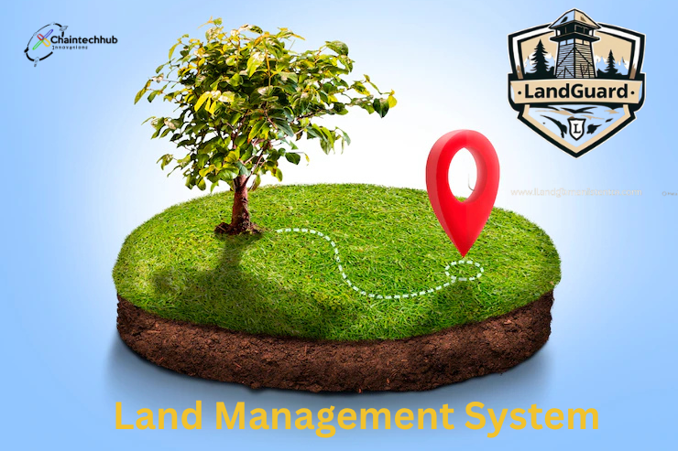
Presented by: Chain Tech Hub
Africa Blockchain Championship 2025
www.chaintechhub.com
Secure Land Ownership
on the Blockchain
"One Deed At a Time"

Slide 2


Problem Snapshot
🧱 70% of land in Malawi is undocumented
🚫 Double-selling & fraud are rampant
⏳ Legal land transfers take months
💸 $250M+ diaspora remittances risk unsafe investments
A Story of Betrayal - Miss R Banda
A Story of Loss - Mrs Grace Phiri

Slide 3

SOLUTION
Impact: Verified. Transparent. Secure land transactions.
🔗 Blockchain-powered land registry
📍 GPS-mapped ERC-1155 land NFTs
🛡️ Real-time marketplace with dispute resolution
📱 Mobile-friendly + offline sync

Slide 4
Buyer accesses verified marketplace and purchases land P2P
Ownership recorded immutably with all metadata linked
Real-time updates, alerts, and resolution in case of disputes
How It Works
Land mapped via GPS and verified by local authorities (Land Code)
NFT minted and stored on blockchain (IPFS and Avalanche)
Land Guard Demo

Slide 5
Unique Value Proposition
First blockchain land registry in Malawi
Supports urban and rural land transactions
Tamper-proof ownership records using NFTs
Peer-to-peer marketplace with real-time updates
Designed for inclusivity: mobile-first, offline sync, low fees

Slide 6
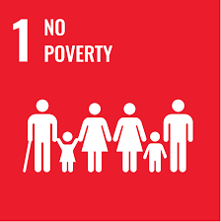


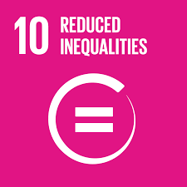




SDGs UNDP Alignment
When your land is secure, your future is possible
From inheritance rights to co-ownership, LandGuard breaks the cycle of silent exclusion
A verified title is more than a document — it’s a gateway to jobs and prosperity
Access to truth is access to power
We can’t build justice alone — but together, we can code it into the continent
Digital deeds mean planned growth
LandGuard empowers owners to think not just of today, but of generations to come
Where ownership is clear, peace is possible.

Slide 7

Tech Stack
Solidity smart contracts (ERC-1155) on Avalanche
GIS integration for land mapping
Frontend: React Native (Mobile), React (Web)
Backend: Node.js, MySQL, IPFS for off-chain storage
QA: Hardhat testing + Fuji testnet deployments
Chain ID: 335
RPC URL: https://subnets.avax.network/defi-kingdoms/dfk-chain-testnet/rpc
Currency Symbol : JEWEL
Explorer: https://subnets-test.avax.network/defi-kingdoms/address/0x4E5446D1De4cd3c6A6a81D6F64d3E323D8c8ee6D

Slide 8
Market Opportunity
1
2
3
4
Malawi land registry reform under 2063 Vision
Over 10 million rural landowners and growing urban market
Diaspora remittances (over $250M/year) seeking safe land investments
Scalable across SADC and East Africa where land issues persist

Slide 9
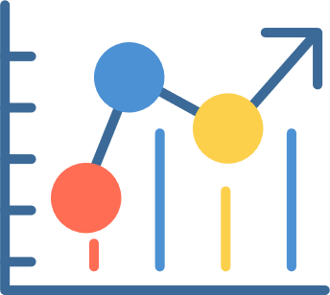
Business Model
One-time NFT minting fee per land registration
Transaction fees on peer-to-peer land sales
API licensing e.g. banks
B2G contracts for land digitization

Slide 10
Competitive Landscape
Platform | Geography | Marketplace | NFT Land Proof | GPS Mapping | Dispute Resolution
LandGuard | Malawi | Yes | Yes (ERC-1155) | Yes | Yes
Bitland | Ghana | No | Yes | Partial | No
Seso Global | Nigeria | Yes | No | No | No
Ubitquity | Global | No | Yes | No | No

Slide 11
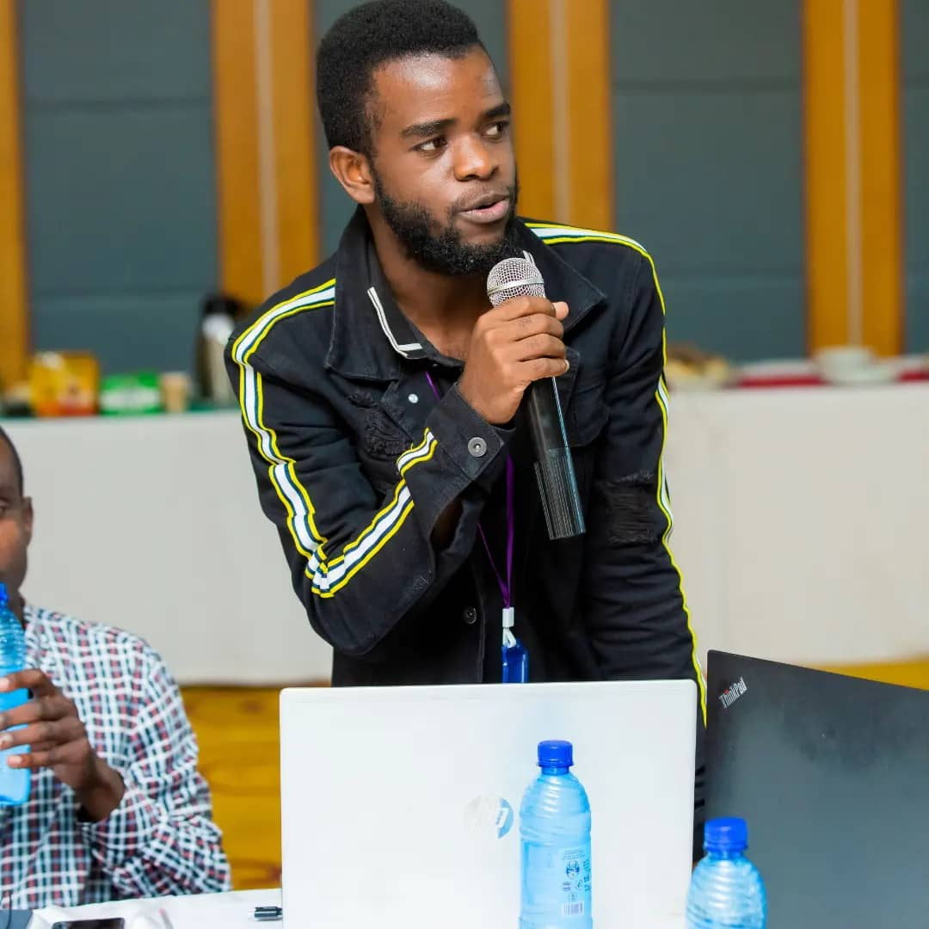
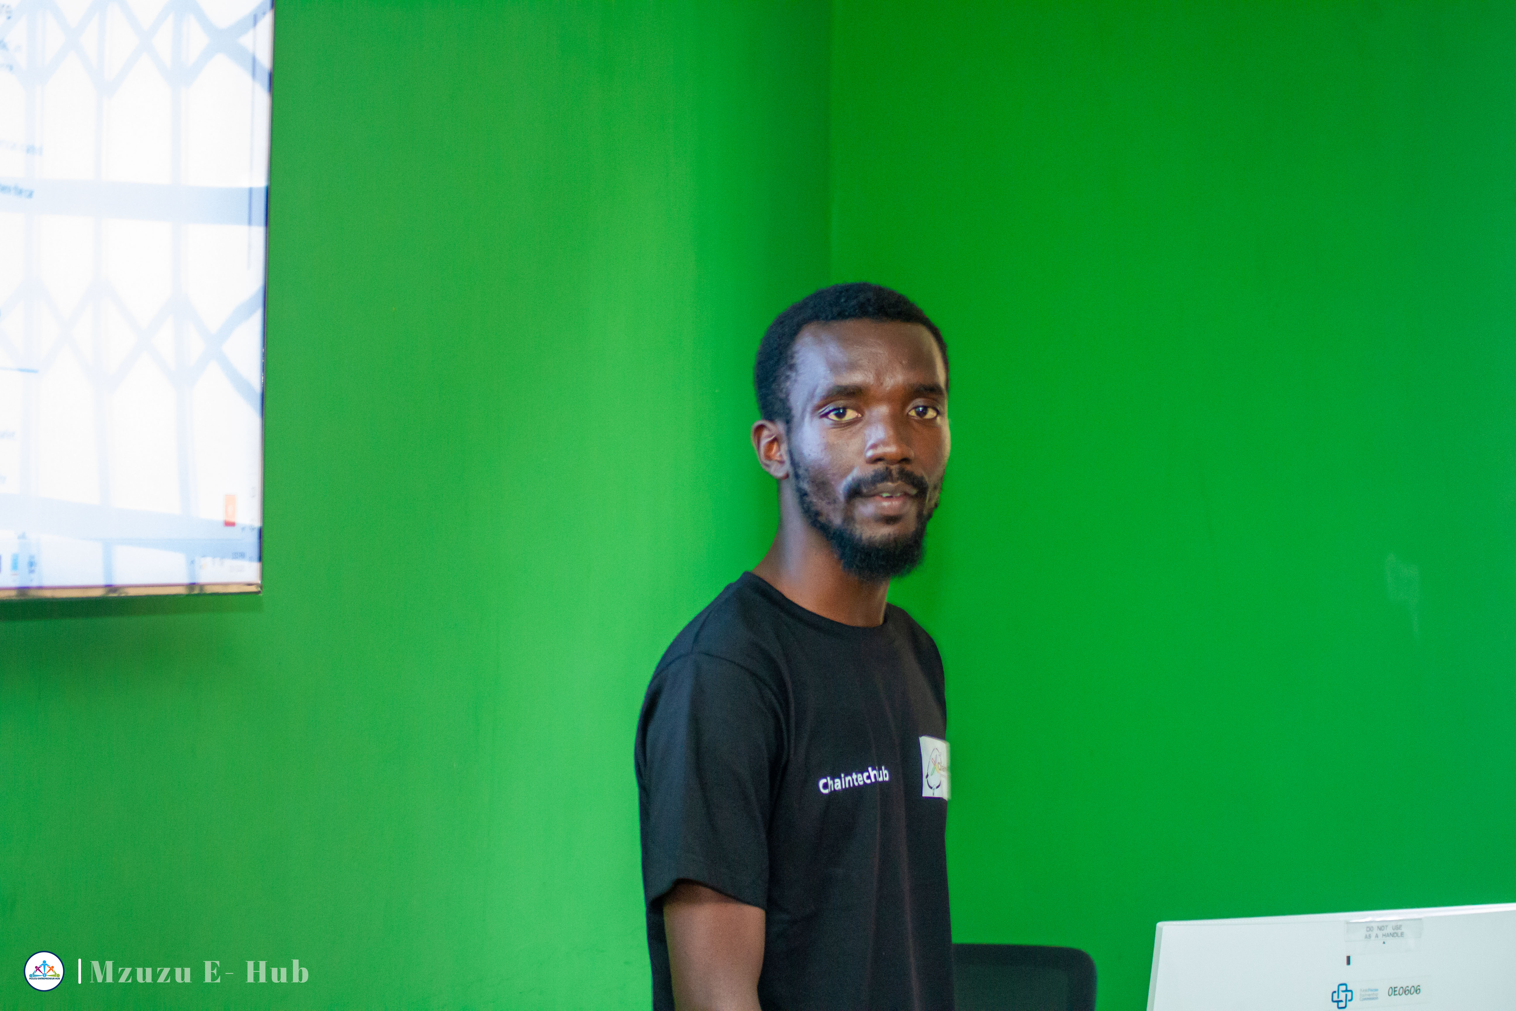
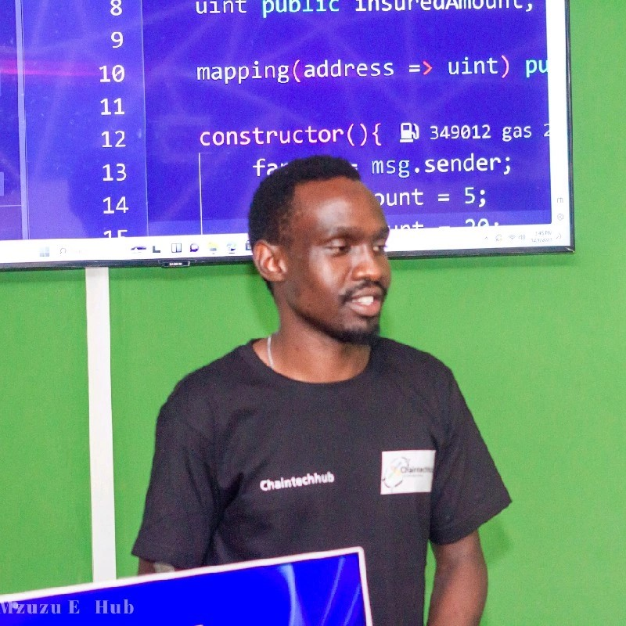
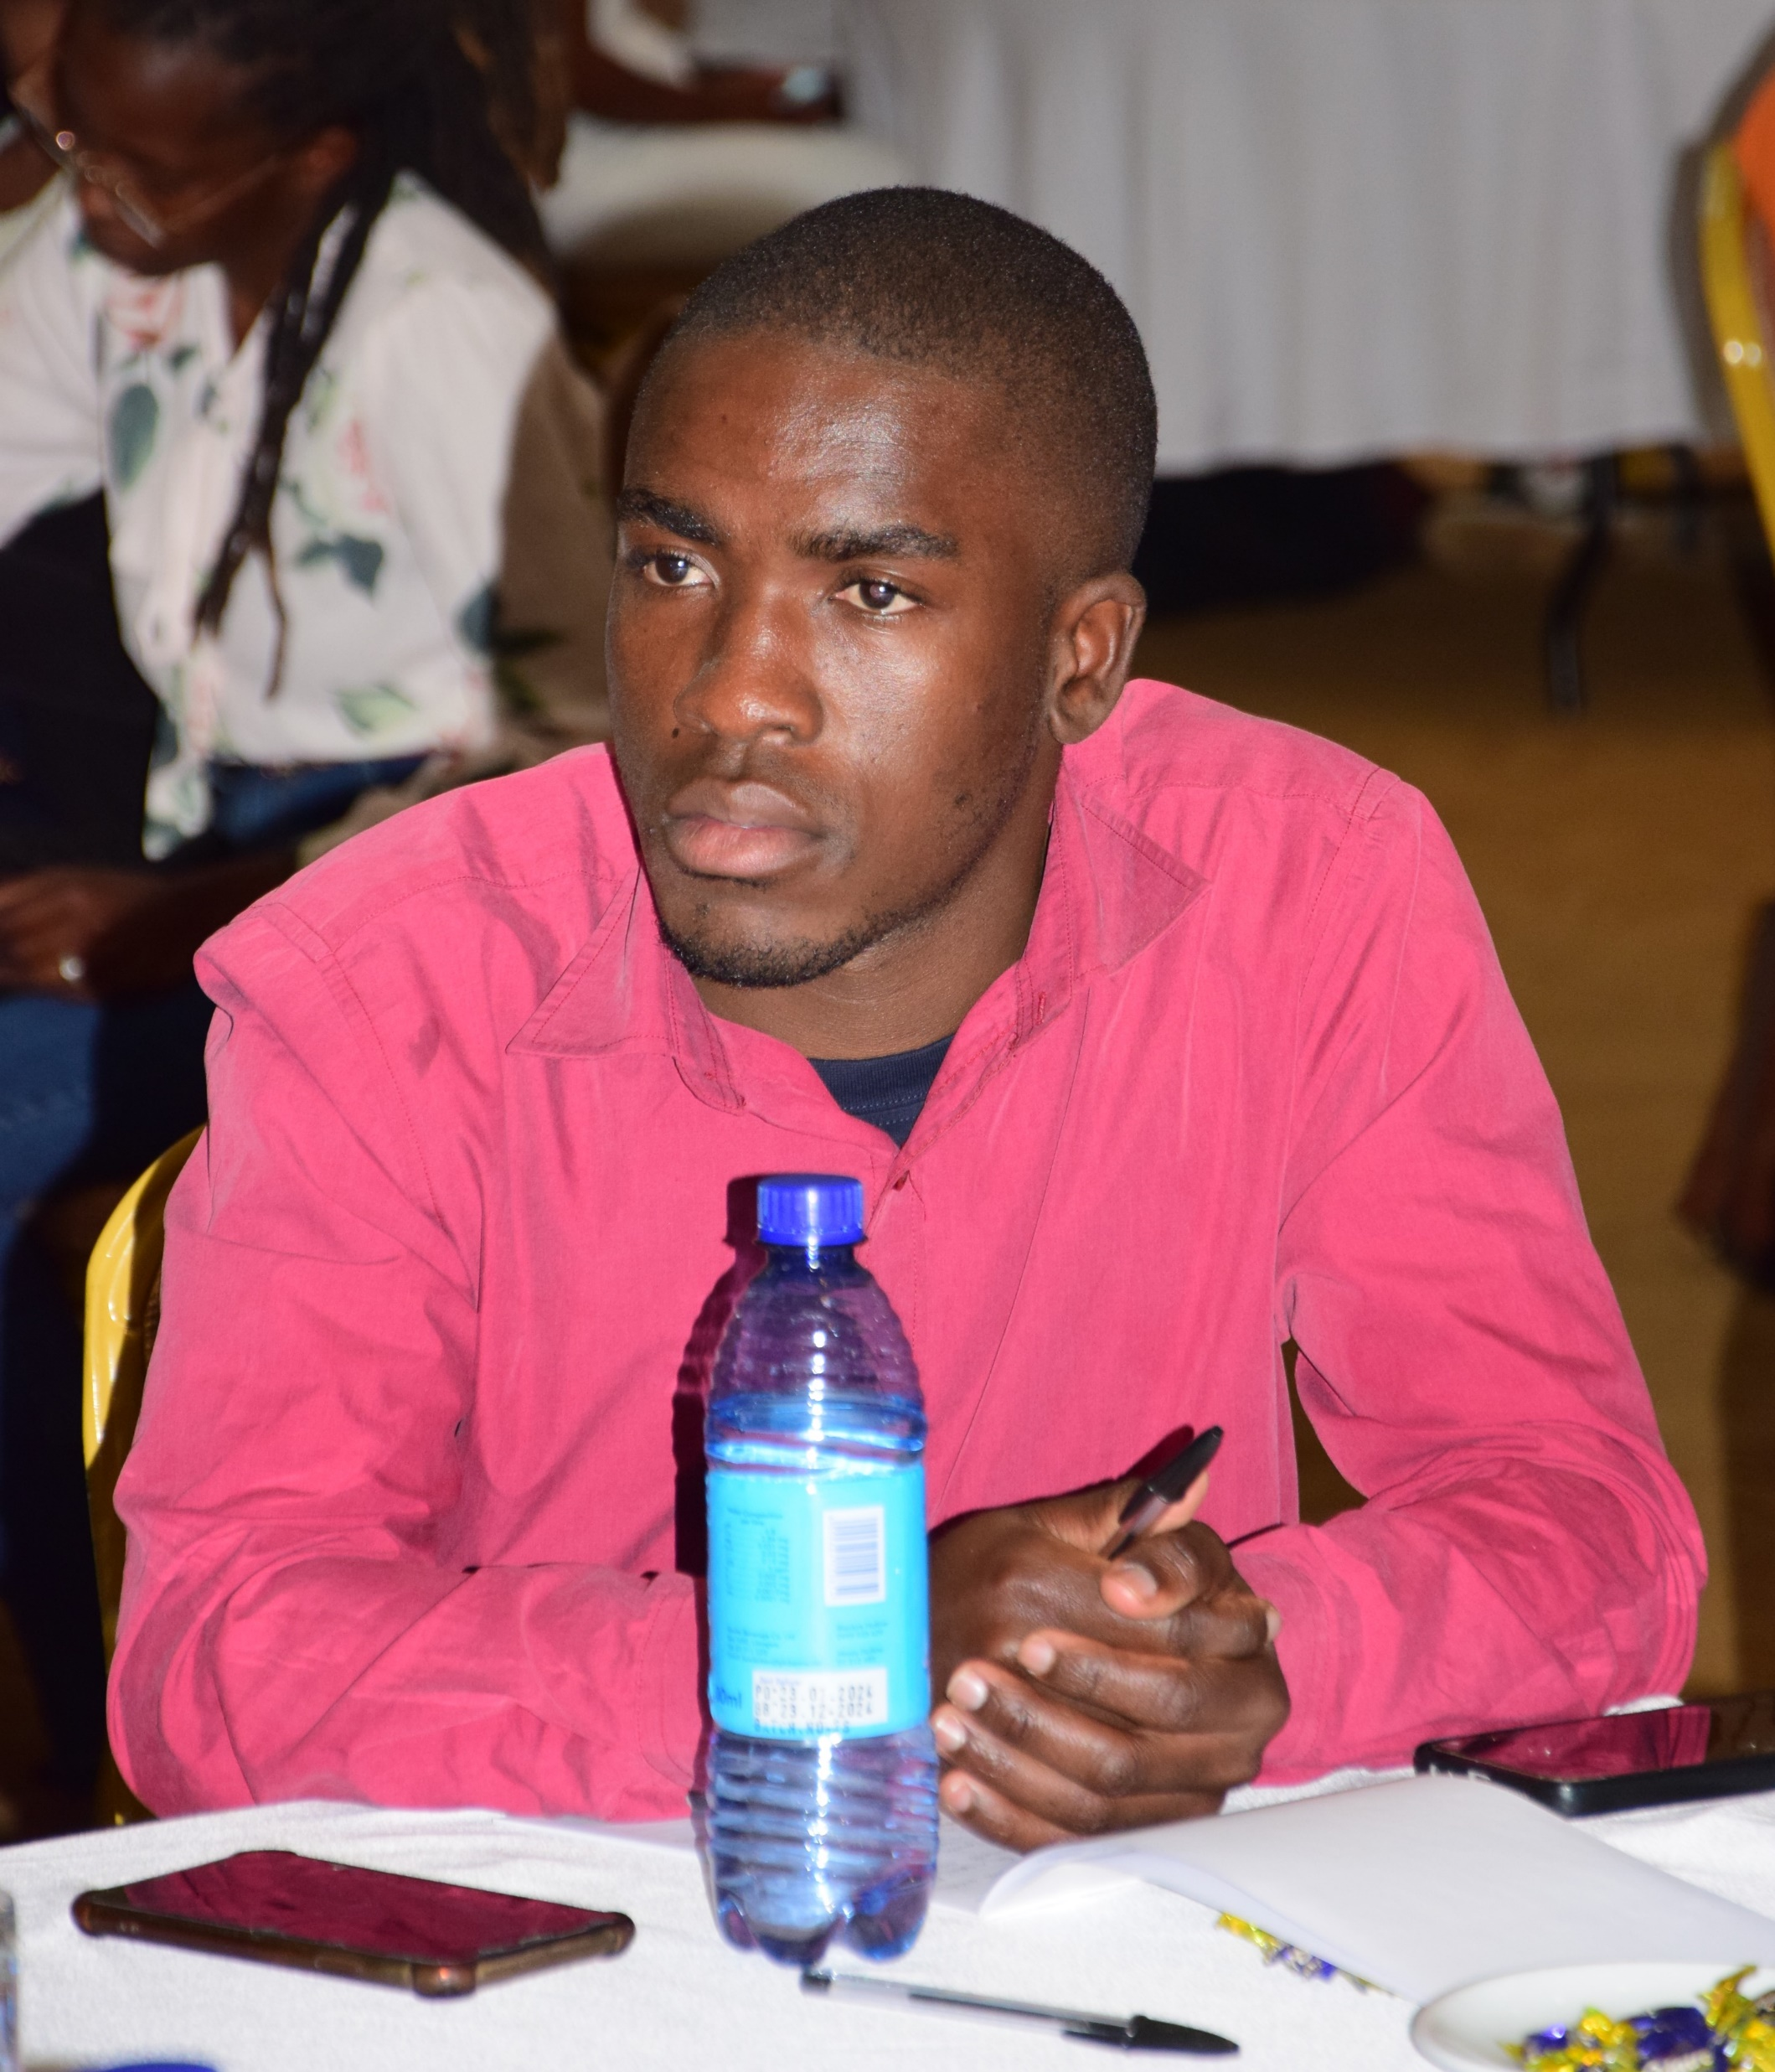

TEAM
Prince Nsusa
BSc ICT & Mathematics
Blockchain Developer
Executive Lead
Jeremiah Somela
BSc Computer Science
Blockchain Developer
Marketing Officer
Christopher Manganyera
BSc Economics
Finance Officer
Blessings Kapalamula
BSc Renewable Energy
Web2 Developer
Technology Officer
Prisca Chifisi
BSc Agriculture
Operations officer

Slide 12
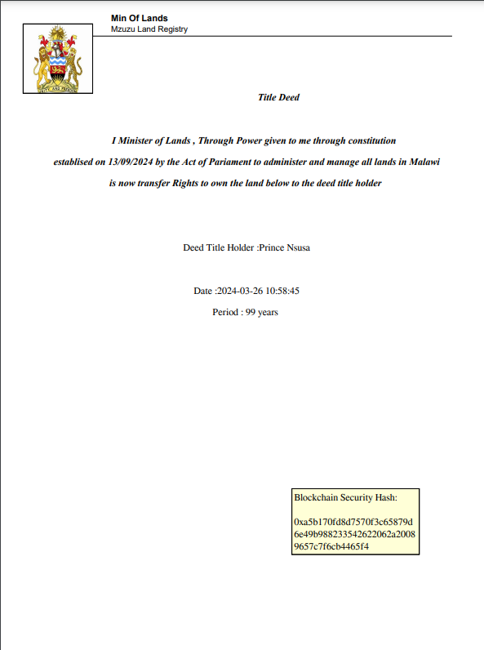

Traction
&
Development Status
MVP deployed on Avalanche testnet ( functional)
GIS mapping module developed & tested
10 pilot users onboarded from peri-urban zones
Marketplace UI + dispute module ready for Avalanche migration

Slide 13


Thank
You
"Securing Africa's land, one deed at a time.“
Connect with us:
chaintechhub.com/landguard
github.com/Chain-Tech-Hub
Partner with us to unlock land justice for millions.
+265-888-001-347
hello@chaintechhub.com

